Slide 1
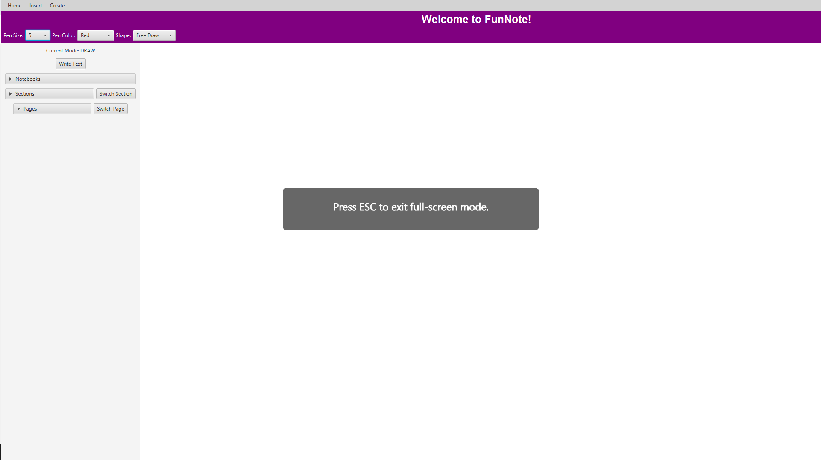
CSC335 FunNote
Authored By: Michael Tuohy, Scott LaFerriere, Trevor Freudig, and Alexander Thompson

Slide 2
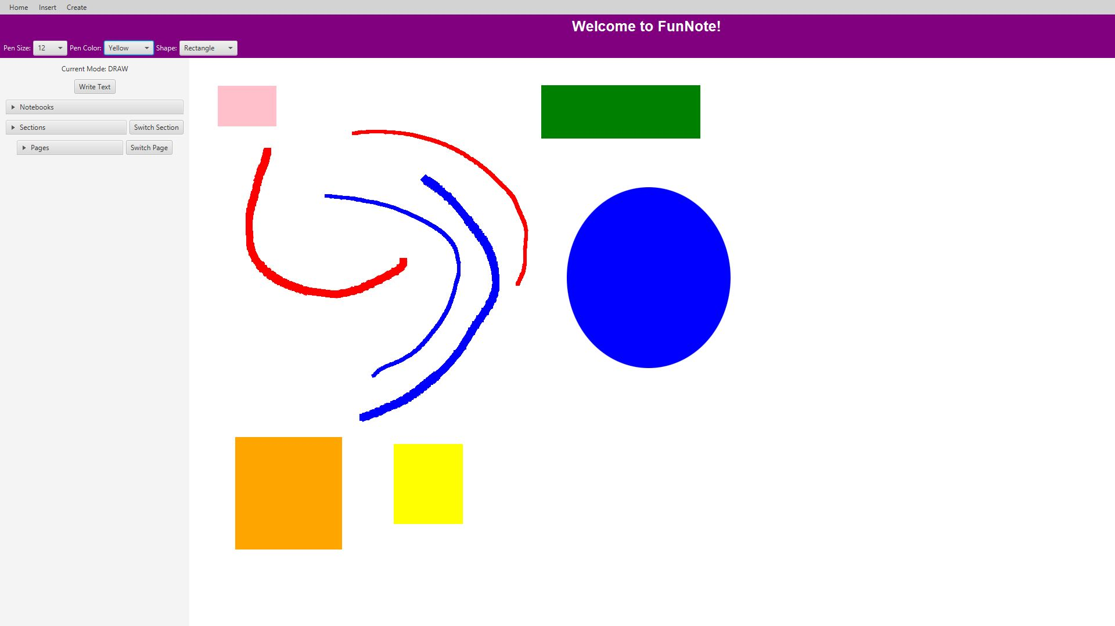
Drawing
Drawing can start immediately, no notebook or page required
Can choose between multiple colors and brush sizes
Can draw with shapes as well as the brush.

Slide 3
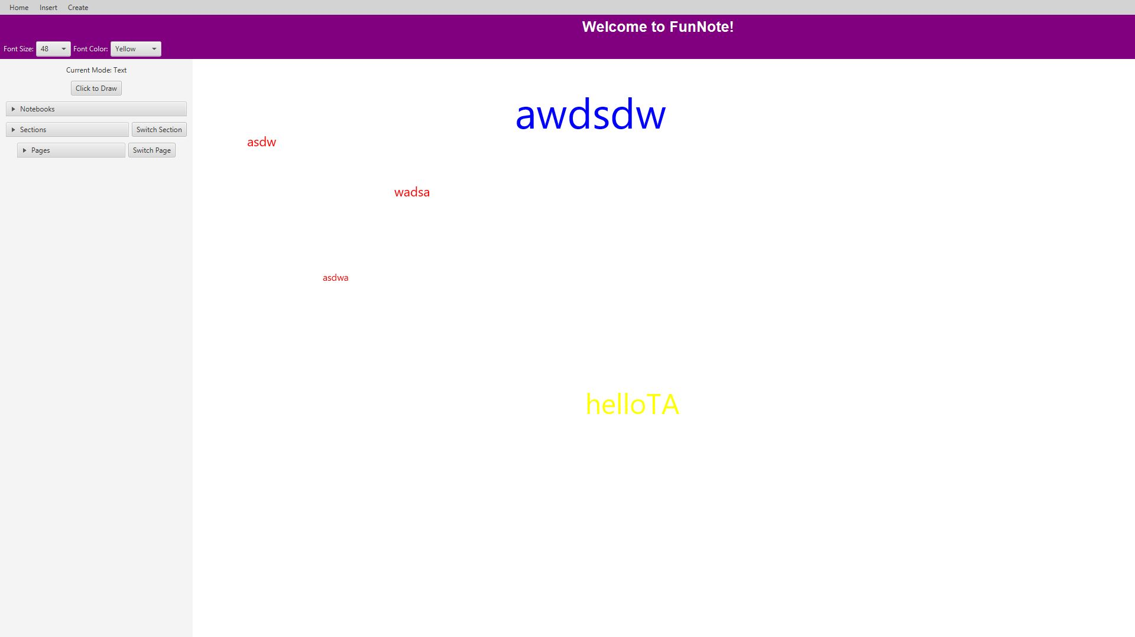
Writing
Users can type text onto the page by clicking the Write Text option
Users can change the font size and the text color with the drop-down menus at the top.

Slide 4
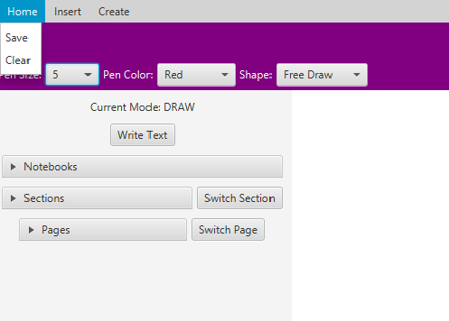
Menu Bar - Home
Save
Saves the current page as a .png
Clear:
Clears any drawing on the current page

Slide 5
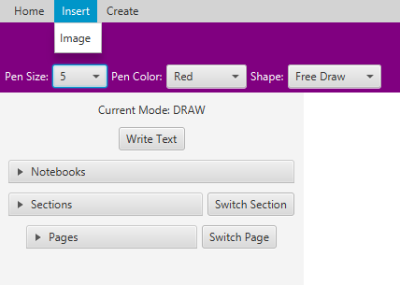
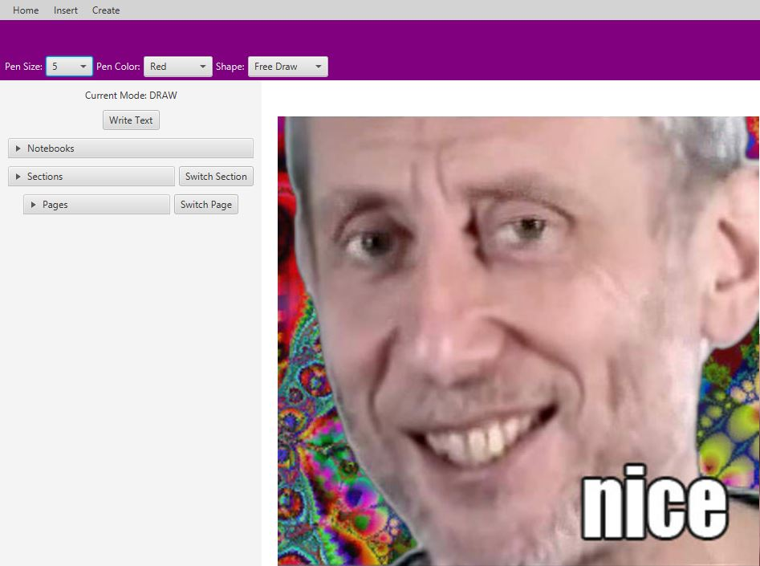
Menu Bar - Insert
Allows the user to paste a Image URL
Then waits for the user to click where they want the image inserted on the current page

Slide 6
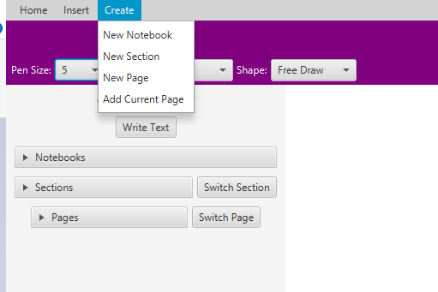
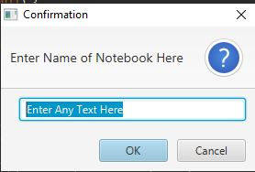
Menu Bar - Create
New Notebook – Create a new Notebook Directory in your storage at a selected Path.
New Section – Create a new section of the notebook in the notebook directory to store pages. Useful to store notes from a specific date or lecture.
New Page – Where users take notes, stored in sections.
Add Current Page – Adds the current page worked on to the section.

Slide 7
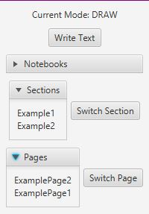
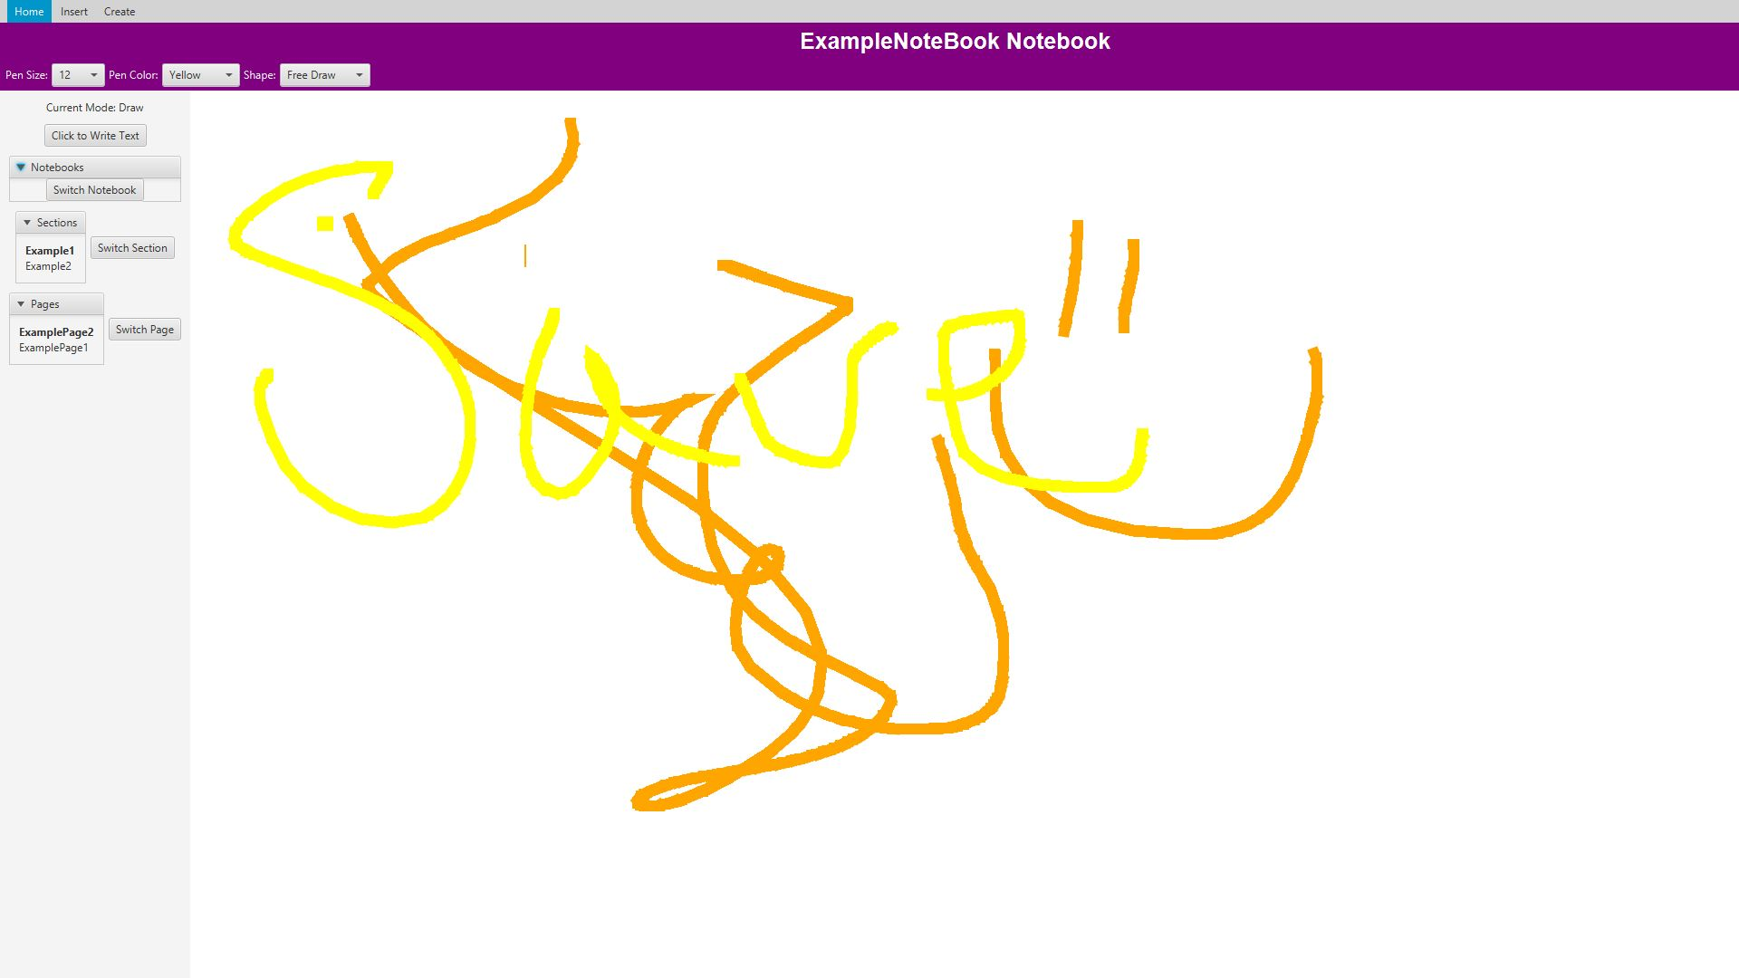
Sidebar
The sidebar allows for easy traversal between Notebooks, Sections, and Pages.

